Slide 1



Indian Premier League (IPL) Strategy for RCB.
(Performance Analysis & Auction Optimization)
Prepared by: Kiran HD

Slide 2



CONTENT OVERVIEW
INTRODUCTION
OBJECTIVE
PROBLEM STATEMENT
DATA OVERVIEW
DATABASE SCHEMA
METHODOLOGY
PERFORMANCE INSIGHTS
STRATEGIC RECOMMENDATIONS
CONCLUSION

Slide 3
INTRODUCTION
The Royal Challengers Bangalore (RCB) has been a competitive franchise in the IPL. Our analysis focuses on understanding the team's past performance, identifying key players, and optimizing strategies for better results in upcoming seasons. This data-driven approach will guide our insights to enhance team performance and capitalize on strengths.
Key Focus Areas:
Performance analysis across multiple IPL seasons.
Identifying high-performing players based on both batting and bowling metrics.
Analyzing home ground advantage and key matches.
Offering strategic recommendations based on the data

Slide 4
OBJECTIVE
Analyze RCB's historical performance trends to identify key success and failure patterns.
Evaluate top-performing players based on batting, bowling, and versatility.
Assess the impact of home ground conditions on RCB's team performance.
Provide actionable strategies and recommendations to enhance RCB’s future performance.

Slide 5
PROBLEM STATEMENT
RCB seeks a comprehensive analysis to identify top-performing, reliable players with consistent contributions in both batting and bowling for the 2017 mega auction, optimizing player investments to enhance IPL success.
The team aims to understand key factors such as team dynamics, home ground advantage, and conditions affecting high-scoring matches to craft a winning strategy.

Slide 6
DATA OVERVIEW
Data Source:
IPL Dataset: Includes tables like matches, player, team, ball_by_ball, wickets, bowling_style, city, extra_runs, etc.
Key Metrics Analyzed:
Batting: Total runs, strike rate, average.
Consistency: Most Man of the Match awards.
Bowling: Wickets, economy rate, effectiveness.
Versatility: Contributions in both batting and bowling.
Team: Match wins, home ground impact.
Tools Used:
SQL Workbench: data querying, extraction.
Excel: visualization, in-depth analysis.

Slide 7
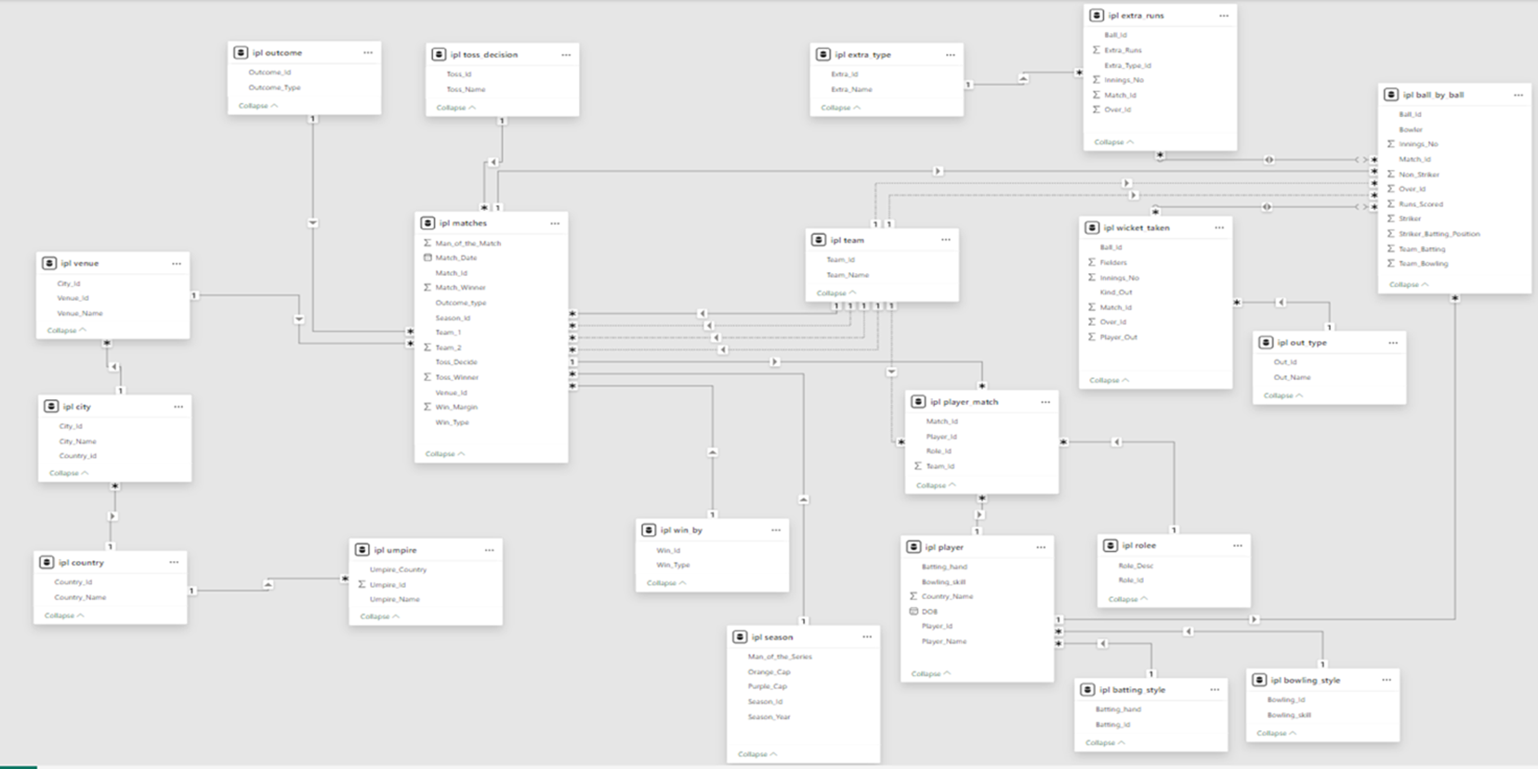
DATABASE SCHEMA

Slide 8

METHODOLOGY
Step 1:
Extract and preprocess data with SQL for batting and bowling metrics.
Calculate player versatility: strike rate, economy rate, impact.
Step 2:
Player Performance Analysis.
Rank players by runs, wickets, strike rate, and economy rate.
Step 3:
Analyze home ground performance and venue impact on results.
Review RCB’s historical performance across seasons.
Step 4:
Provide recommendations based on player performance and team dynamics.
Use data insights to optimize strategies and player roles.

Slide 9
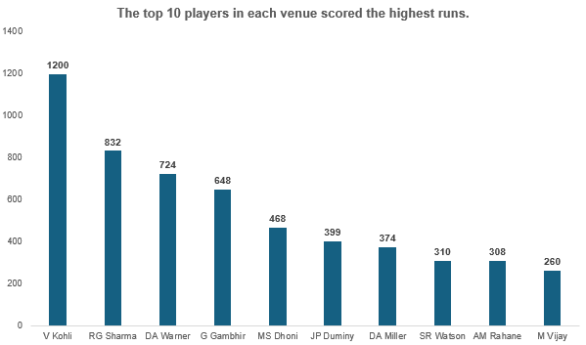
PERFORMANCE INSIGHTS
Top Player in Batting Scores
Objective: Identify batters with high scores, averages, and strike rates.
Analysis: Focus on players with consistent averages, high strike rates, and total runs.
Insights: Top batters combine consistency with explosive scoring.

Slide 10
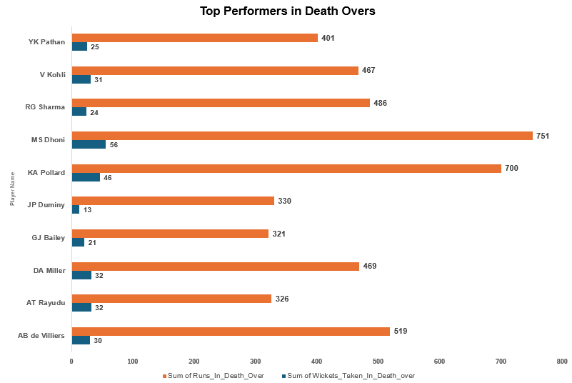
PERFORMANCE INSIGHTS
2. Top Performers in Death Overs
Objective: Identify players excelling in death overs (last 4 overs) by runs and wickets.
Analysis: Batters with high strike rates and bowlers with wickets in death overs.
Insights:
Top Finishers: AB de Villiers, MS Dhoni excelled under pressure.
Top Bowlers: Bumrah, Malinga dominated with wickets and economy.

Slide 11
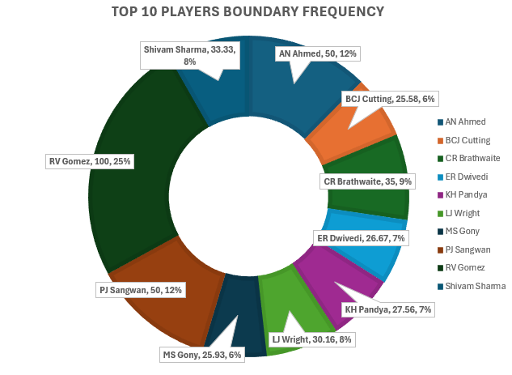
PERFORMANCE INSIGHTS
3. Boundary Frequency
Objective: Identify players with high boundary frequency and impact on scoring rates.
Analysis: Calculated boundary frequency for top batsmen.
Insights:
RV Gomez and AN Ahmed excel in boundary frequency.
Consistent boundary hitters boost rapid scoring in T20.

Slide 12
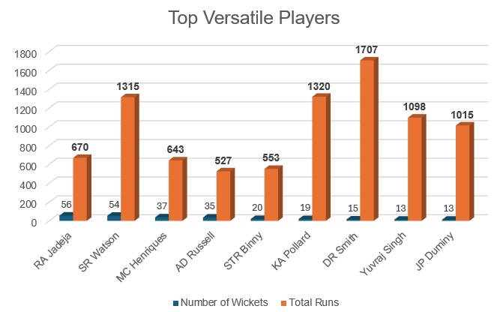
PERFORMANCE INSIGHTS
4. Elite Batting and Bowling Contributors
Objective: Identify players excelling in both batting and bowling.
Analysis: Evaluate players with strong runs and wickets for all-round performance.
Insights:
All-rounders like Watson and Jadeja excel in both disciplines.
Their versatility offers crucial adaptability, shifting match momentum.

Slide 13
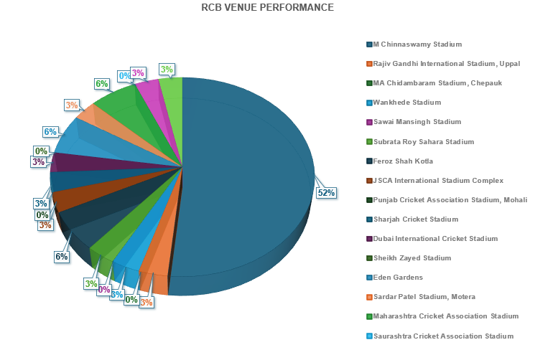
PERFORMANCE INSIGHTS
5. Home Ground Performance
Objective: Analyze RCB’s performance at M. Chinnaswamy and other home venues.
Analysis: Calculated win percentage at each venue.
Insights:
RCB’s home win percentage varies, needing adjustments.
Strong home performance and chasing ability boost standings.

Slide 14
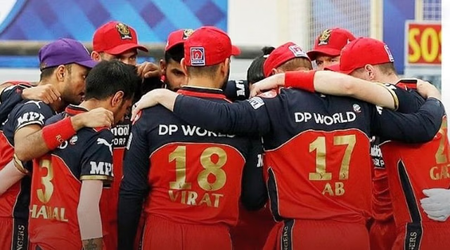
STRATEGIC RECOMMENDATIONS
1. Strengthening Death Over Strategy
Insight: Death overs (16-20) are crucial; RCB struggles in bowling.
Recommendation:
Acquire death-over specialists like Bumrah and Morris.
Use proven bowlers for tight Yorkers and slower balls.
Train Siraj and Harshal to specialize in death-over strategies.

Slide 15
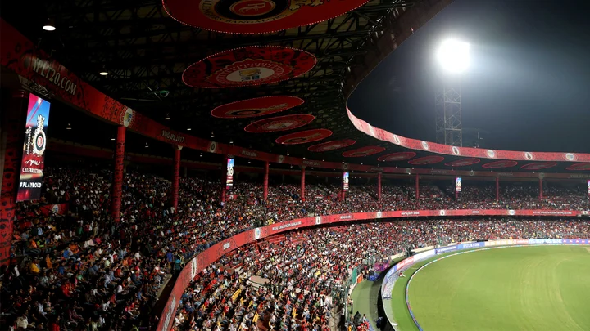
STRATEGIC RECOMMENDATIONS
2. Home Ground Advantage Utilization
Insight: M. Chinnaswamy is a high-scoring venue, favoring explosive batsmen.
Recommendation:
Strengthen batting with hitters like Maxwell and AB de Villiers.
Build a team of fast-scoring batsmen and defensive bowlers.
Focus on chasing, as RCB excels when batting second.

Slide 16
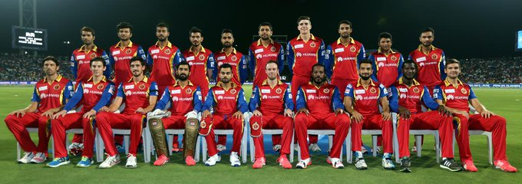
STRATEGIC RECOMMENDATIONS
3. Prioritize Versatile All-rounders
Insight: All-rounders enhance team flexibility, crucial in T20.
Recommendation:
Acquire or retain all-rounders like Pandya and Stoinis.
Develop Sundar for a more versatile role.
Use all-rounders strategically in key overs for batting or bowling impact.

Slide 17
CONCLUSION
Build a team with versatile players and death-over specialists.
Leverage home advantage with explosive batting.
Acquire players who perform under pressure in batting and bowling.
Strengthen batting with backups and bowling with experts like Narine, Malinga, and Ashwin.
Consistent strategies will improve RCB’s performance and boost IPL chances.

Slide 18
THANK YOU

